Slide 1
JOGIN
Login을 즐겨라!
보람상 조
2014 이 분홍
2014 조 규상

Slide 2
06/
Primary
Code
03/
Tools
02/
04/
Algorithm
Related
Research
&
PD
05/
Scope
&
Improvement
07/
Schedule
01/
Introduction
&
Application
08/
Result
Video
CONTENTS

Slide 3
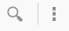
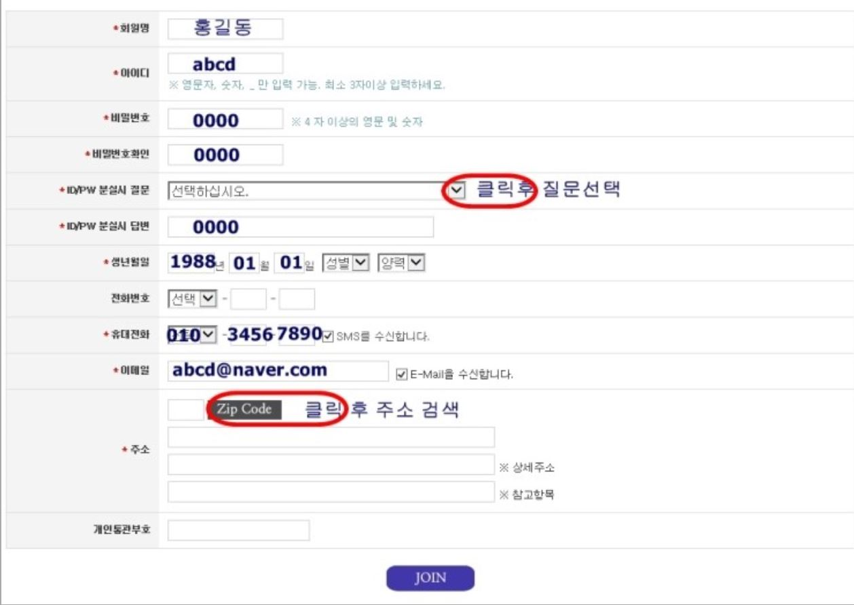

1. Introduction
Introduction l Related Research l Tools l Algorithm l Schedule
Membership
When you become a website member, you always have to fill these forms.
It’s very annoying and take a long time.

Slide 4
1. Introduction
Application l Solution l Tools l Algorithm l Schedule
SO, It’s time to use JOGIN!
Purpose
Reduce the time to join website
Simplify join membership

Slide 5
1. Introduce Application
Application l Solution l Tools l Algorithm l Schedule
Functions
Save and management member information
Issue the approval number
Send your information to webpage directly

Slide 6
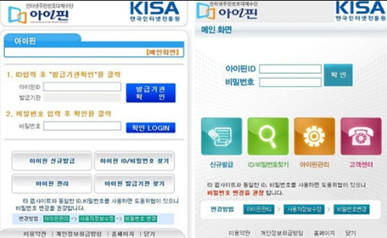
2. Related Research
Introduction l Related Research l Tools l Algorithm l Schedule
1. I - PIN
▣ Another method to make ID
▣ Kind of authentication certificate
▣ Safe and secure

Slide 7
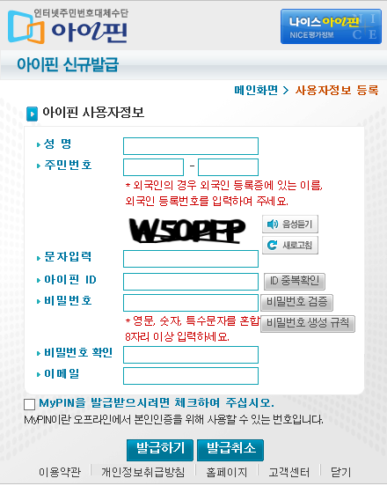
2. Problem Definition
Introduction l Problem Definition l Tools l Algorithm l Schedule
1) PD
▣ Too complicated to issue I-Pin
▣ They still require resident registration number
▣ If you forget I-Pin ID and PW, you have to fill these form again to find your I-PIN

Slide 8
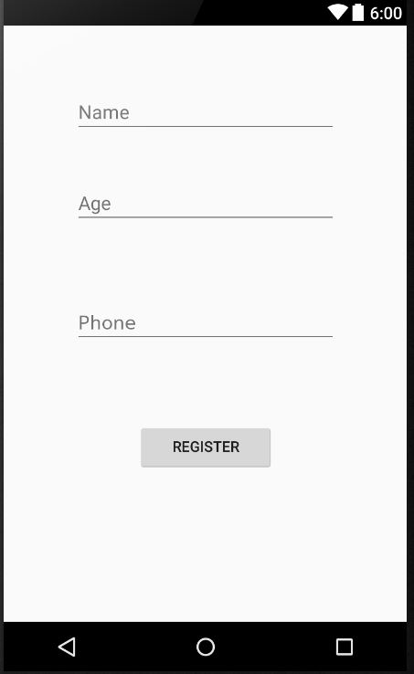
2. Solution
Introduction l Solution l Tools l Algorithm l Schedule
2) Solution
▣ Simplify member admission
▣ We do not require resident registration
number suitable for these days
▣ You don’t have to make ID and PW for these app. Just register your personal information.

Slide 9
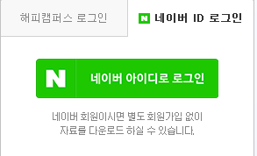
2. Related Research
Introduction l Related Research l Tools l Algorithm l Schedule
2. Login with another website ID
▣ Another method to join website
▣ Using another website ID to login
▣ Very fast and simple method
Ex) 네이버 아이디로 로그인
[ Using naver ID to Login ]

Slide 10

2. Problem Definition
Introduction l Problem Definition l Tools l Algorithm l Schedule
1) PD
▣ A small number of homepages adopt this method to login because they need information of users

Slide 11
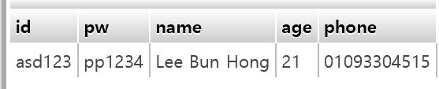
2. Solution
Introduction l Solution l Tools l Algorithm l Schedule
2) Solution
▣ We make website DB as well as application DB

Slide 12





3. Tools
Introduction l Related Research l Tools l Algorithm l Schedule

Slide 13
4. Algorithm
Introduction l Related Research l Tools l Algorithm l Schedule
Register user information using JOGIN
↓
Save information in application DB
↓
Approval Number is given
↓
At webpage, the approval number is required
↓
At webpage, write down only ID and PW, what you want
↓
Admission Success

Slide 14
5. Scope of Implementation
Introduction l Related Research l Implementation l Algorithm l Schedule
Implementation
Limitation
▣ Register your personal information into app
▣ Vulnerable for security
▣ Join arbitrary website, what we made
▣ It can be used at website, which our technique is applied
▣ Your personal information is pass to the website
▣ Modify user information
(additional function)

Slide 15
5. Improvement
Introduction l Solution l Tools l Algorithm l Schedule
Direction of Improvement
Add device registration to enhance security
Give systematic approval number
Expand database columns

Slide 16
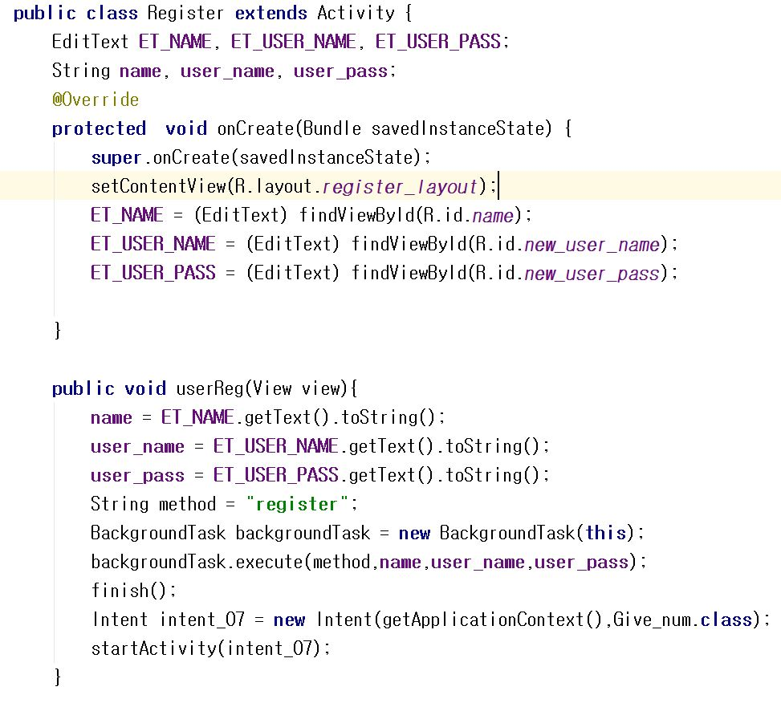
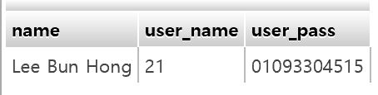
6. Primary Code
This code saves your personal information to application DB

Slide 17
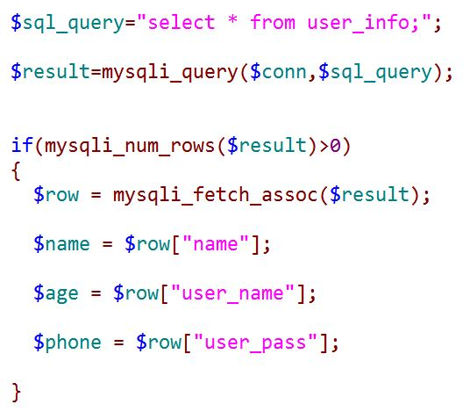
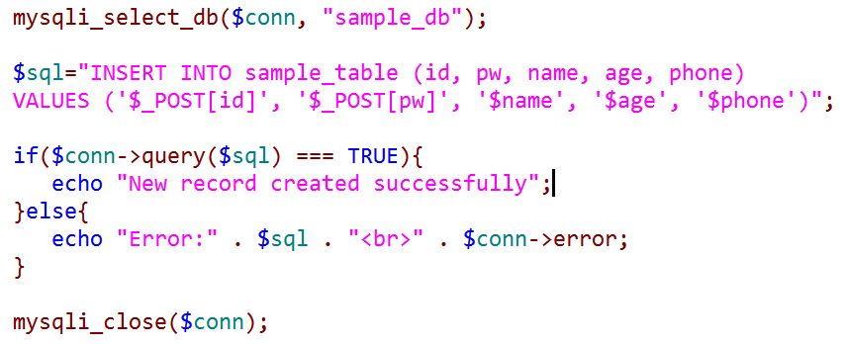
6. Primary Code
This code sends your personal information to website DB
This code is combined with your personal information, and then save into webpage DB

Slide 18

7. Schedule
Introduction l Related Research l Tools l Algorithm l Schedule
10. 28 제안서 작성 및 알고리즘 구현
11. 05 중간 발표 및 간단한 Activity 구현
11. 12 DB 구현 및 연동
11. 30 최종 발표
11. 24 메인 사이트 구현 및 연동
11. 17 DB 구현 및 연동 마무리
12. 05 최종 제안서 작성 시작
12. 12 최종 보고서 제출

Slide 19

8. Result Video

Slide 20
9. Creating Profit
How to Create the Profit?
Partnership with other websites and offer our services.
As a result, we can get profits of usage fee

Slide 21

THANK YOU

Slide 22
Any Question?

